Slide 1


#LifeKoKaroLift

Slide 2



Session On : Git Workflows

Slide 3



Poll 1
Git _______ ?
Helps in tracking changes in source code
Makes it easy to do application lifecycle management
Helps in project task management
Allows to track defects
Practice in teams of 4 students
Industry expert mentoring to learn better
Get personalised feedback for improvements
09-08-2019
11

Slide 4
Poll 1 - Answer
Git _______ ?
Helps in tracking changes in source code
Makes it easy to do application lifecycle management
Helps in project task management
Allows to track defects
Practice in teams of 4 students
Industry expert mentoring to learn better
Get personalised feedback for improvements
09-08-2019
11

Slide 5
Git : An Overview
Git is a open source distributed version control system.

Slide 6
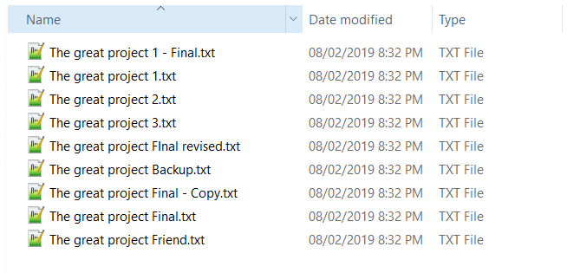
Git : Why we need version control ?

Slide 7
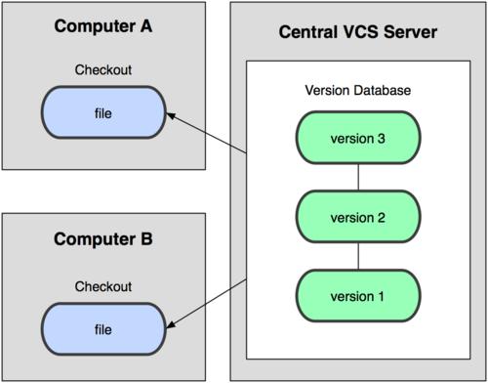
Git : Centralized Vs Decentralized

Slide 8
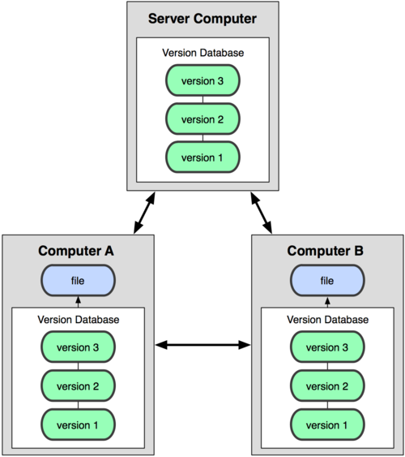
Git : Centralized Vs Decentralized

Slide 9
Git : Benefits of Decentralized System
Everything is fast
Every clone is a backup
Work offline

Slide 10
Workflows
Centralized Workflow
Feature Branch Workflow
Gitflow Workflow
Forking Workflow

Slide 11
Workflows
What makes a workflow?
Notes:
recommendation for how to use Git to accomplish work in a consistent and productive manner.
Given Git's focus on flexibility, there is no standardized process on how to interact with Git

Slide 12

Centralize Workflow

Slide 13
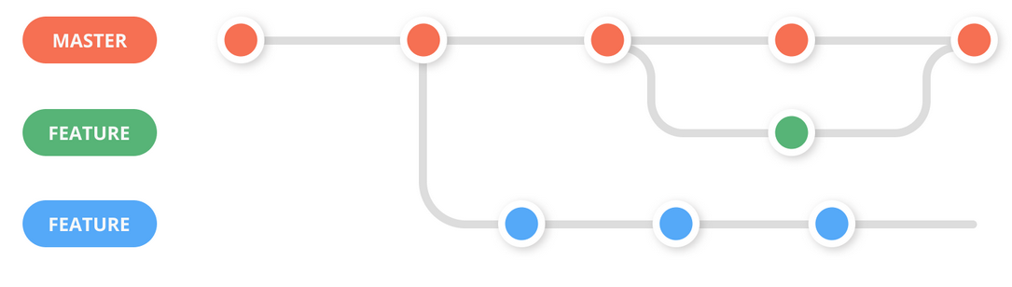
Feature Workflow

Slide 14
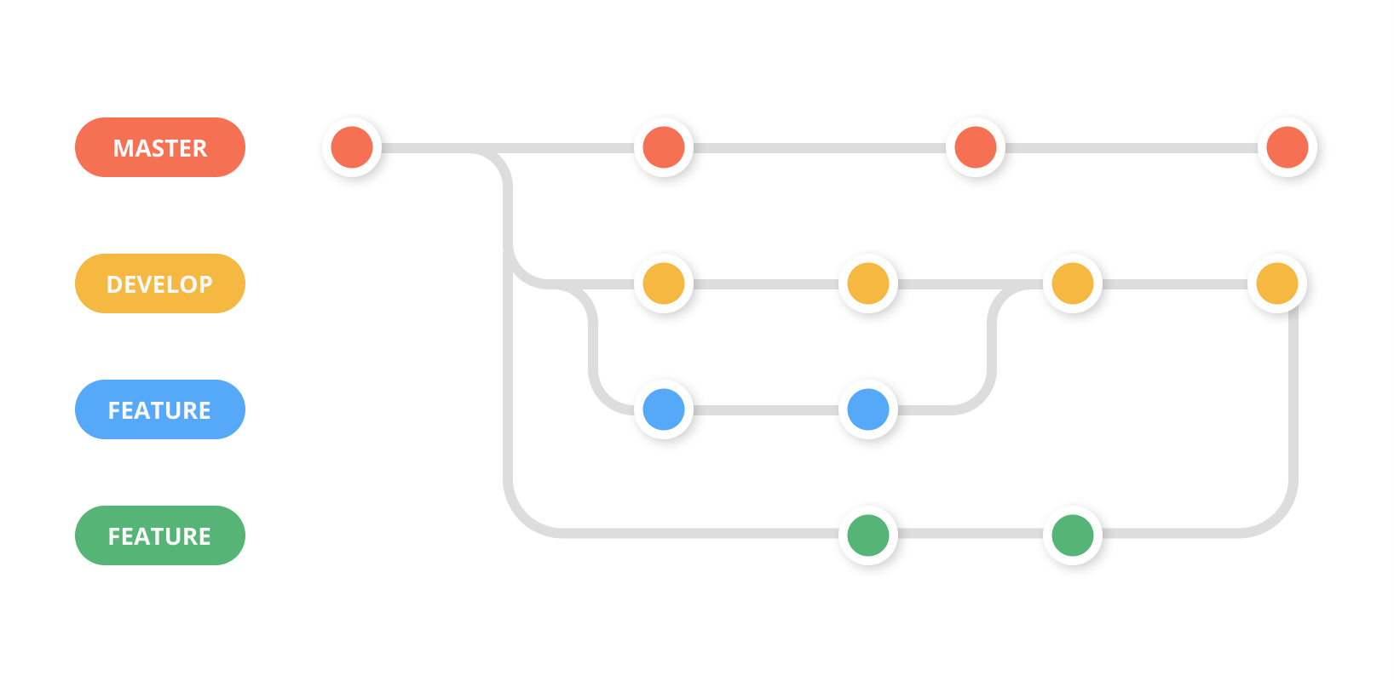
Feature Workflow – with Dev branch

Slide 15
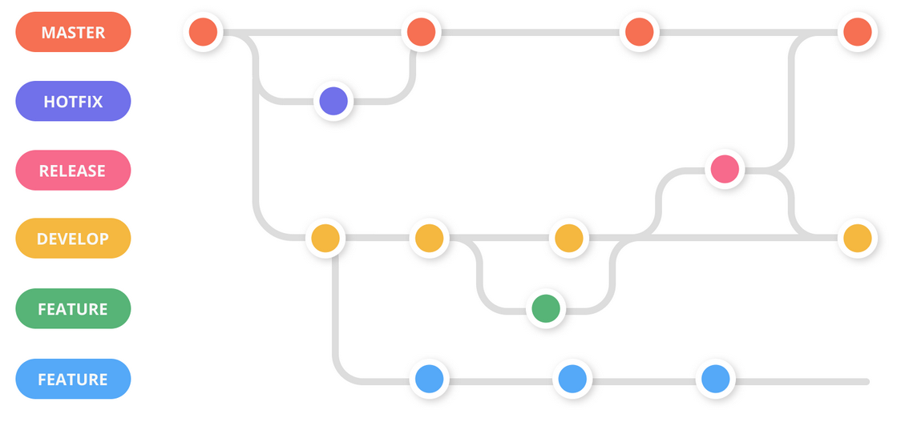
Gitflow Workflow

Slide 16
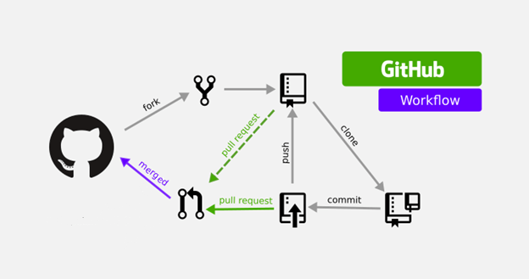
Forking Workflow

Slide 17
Best Practice
How to choose workflow?

Slide 18
Questions !
There are no silly questions, just silly answers!

Slide 19
#LifeKoKaroLift
Thank You!

